Slide 1


Technical Presentation Library Management System- Using Blockchain Group ID- B-24 Under the guidance of: Mr. Sushil Kumar Saroj (Assistant Professor CSED)
Madan Mohan Malaviya University of Technology
Gorakhpur (U.P.) India 273010
Submitted by:
Prashant Singh(2019021106)
Vivek Goswami (2019021168)
Ujjawal Gupta (2019021160)
Submitted to:
Computer Science and Engineering Department

Slide 2
Abstract
This website is designed with the purpose of allowing buyers and sellers to indulge in buying and selling of books online along with rental services available.
The whole library management system is integrated with Blockchain which has increased the security of the transactions as well as ownership of the books, as one of the major challenge of such a library management system is that often times ownership of books is altered due to the flaws in security of the system.
The concept of decaying NFT is used for implementing rental services of the books. As the online warranty is used as the period of the rental service of the book and as soon as the warranty is expired, so does the rental period of the book rented.

Slide 3
Use Cases
Blockchain smart contracts allow users to prove ownership by utilizing the concept of NFTs.
The legitimacy of the books can be proved. Warranty cards will show the purchasing history, warranty period, and other information regarding the books.
Protecting Businesses from Chargeback Fraud. More secure and trustworthy.
Direct transfer of NFT from owner to the buyer(Faster Transactions). Peer to Peer payments/ Crypto Payments can also be incorporated.
Block chain can be utilized in the library management to develop a decentralized online buying and selling platform. No third party needed.
A More Transparent Library Management System

Slide 4
Problem Statement
Security of ownership of the warranty of books and books themselves is the main concern regarding the library management system. Often times it is seen that ownership of books is altered due to flaws in the security of the library management system.
When books are rented from the library, there are instances when books are not returned on time, and the seller needs to have verified proof claiming ownership of the books.

Slide 5
Problem Solution
The library management system is integrated with blockchain technology to overcome the problem of violations of the rental contract and alteration of ownership of books, as blockchain creates Non-Fungible Tokens.
These Non-Fungible Tokens are unique and cannot be tampered and the concept of decaying warranty is used to implement the feature of the rental period.

Slide 6
Features of Application
A Library Management System is a web-based application through which buyers and sellers can buy and sell books along with the feature of renting books. It is integrated with blockchain, which has enhanced the application's security by many folds. Various features of the application are as follows:
• It has the support of a super-admin panel which provides the owner of the application with great functionalities and flexibility, such as adding (an NFT is minted) and deleting books from the application. It also allows the owner to have an insight into various statistical data regarding buying and selling of books. It also provides the owner with all the data of buyers and sellers present on the platform.
• Buying and selling of books: When a book is bought by a user, its NFT is transferred to the address of the smart contract.
• Various statistics of data related to the buyer and seller are available in the super admin for which MongoDB charts are used.

Slide 7


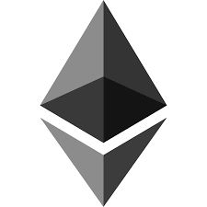
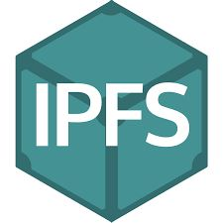
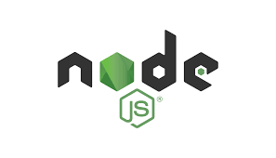
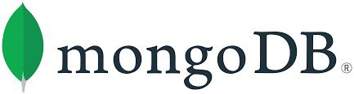
Tech Stack
Frontend- ReactJS.
Backend- NodeJS
Database- MongoDB
Blockchain- Ethereum Blockchain, Solidity Language, ERC 721 Smart Contract, IPFS, Metamask

Slide 8
The technology used in the above project is MERN stack and Ethereum Blockchain. React js is used for frontend part that is for the user side and admin panel. Node js is used for the backend part. MongoDB database is used to store the details of the books in the database that are later being fetched in the client side. Smart contracts are written in the solidity language and are deployed in the Ethereum Blockchain.
IPFS is used to store the metadata of the books that is sent in the blockchain, and this can not be altered by anyone, so it is more than secure. ERC 721 smart contracts are used that shows the ownership in the form of NFTs(Non Fungible Tokens).

Slide 9
Working of Library Management System
Library Management System has mainly three functionalities whose working is explained as follows:
* Selling and Registration: NFT is created at the time of book’s registration using the token URL provided by IPFS. If any book is for sale then the owner’s address will be the contract address on the blockchain. Else if the item is not for sale, then the owner’s address and contract’s address will be different, which further gets changed if the owner wants to sell the book.
* Buying: On buying books, ownership of NFT is transferred from seller to buyer.
* Decaying Warranty: At the time of registration admin provides a certain period of warranty which acts as a rental period, and gets stored in IPFS. The buyer and seller will have total information on the history and warranty period. After the warranty period is over NFT gets burned.

Slide 10
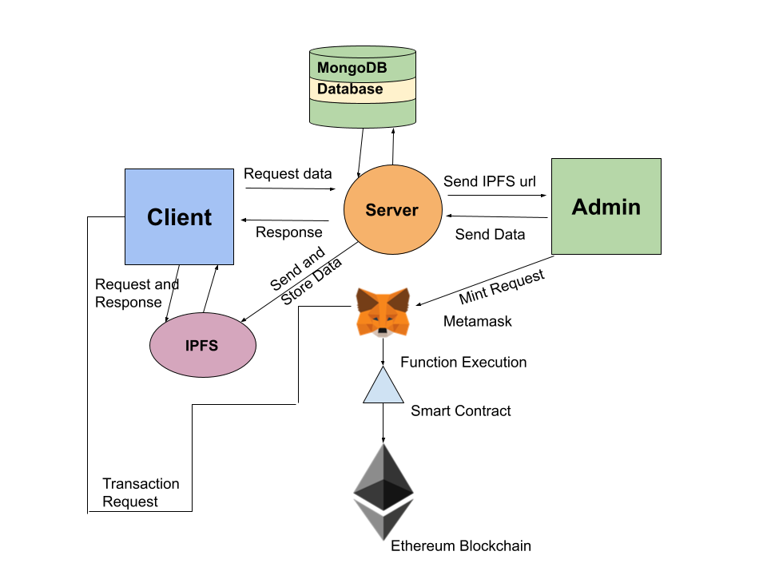
Block Diagram

Slide 11
Conclusion
A library management system integrated with blockchain technology can be very beneficial in many cases as discussed in the beginning of the report. Hence, this application can be implemented practically and with good security features and many other features that make the exchange of books a cakewalk for users. Although such trading practices can lead to limited options for people, negotiation on prices will be limited. But there are cases where options availability doesn’t matter much. Rather security of transactions matters a lot. Hence for promoting a secure transaction, such methods can be adopted, and the application serves the purpose successfully.
Also, the application can be improved by adding more features such as adding real-time chat features so that users can talk to one another on the application itself, adding UPI features for payment as they are being used nowadays on a large scale, and scanning ID proof of users. At the same time, registration will also increase an application's security

Slide 12
THANK YOU

